Slide 1

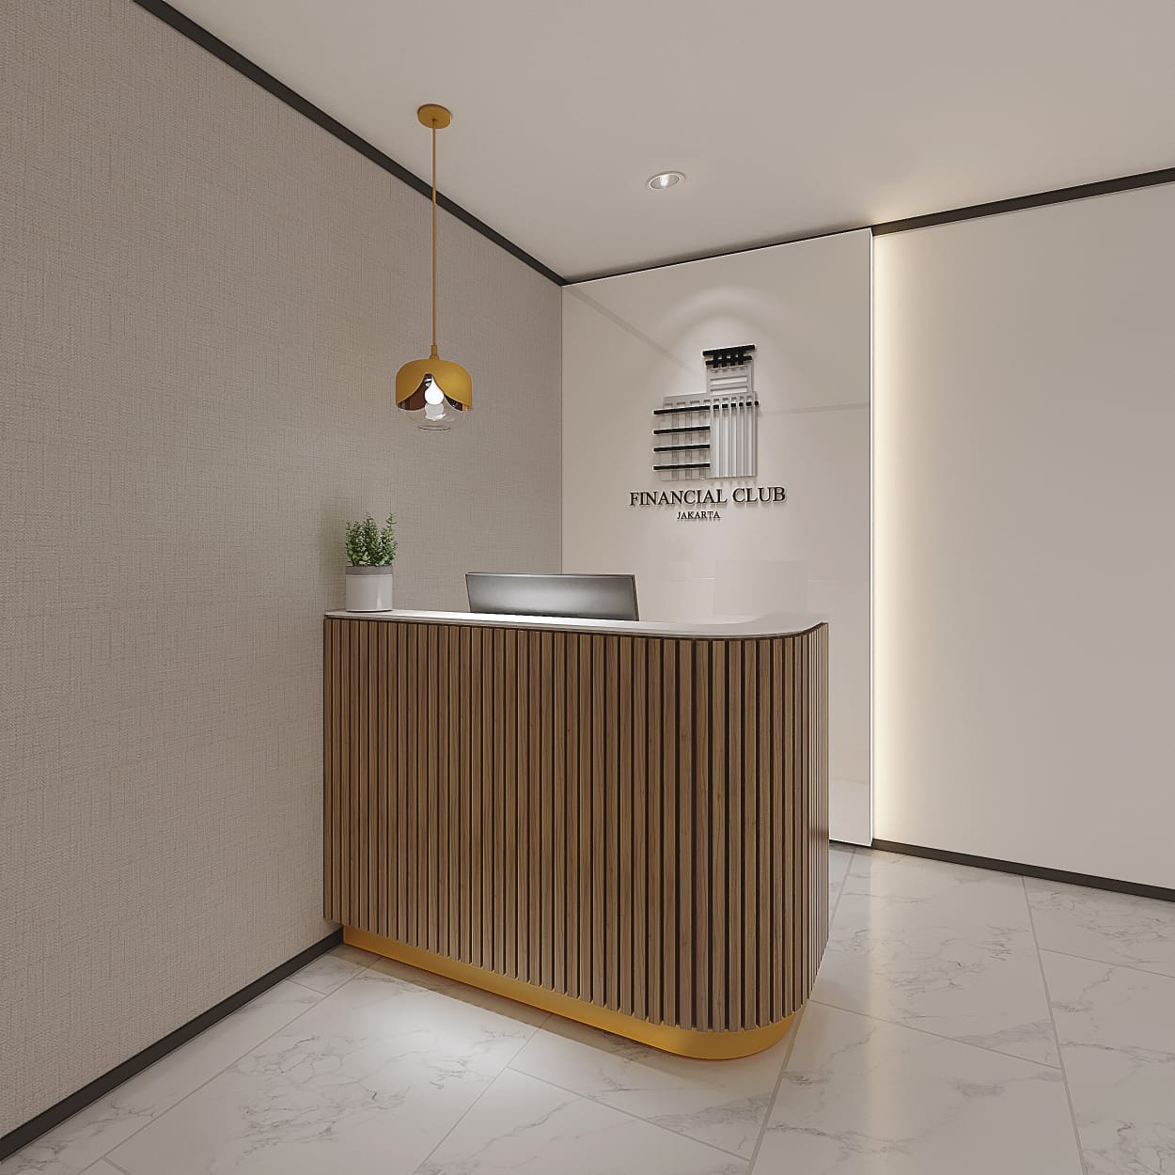

your business solution
Graha CIMB Niaga, 11th floor
Jl. Jendral Sudirman Kav.58 Jakarta Selatan www.financialsuite.com

Slide 2

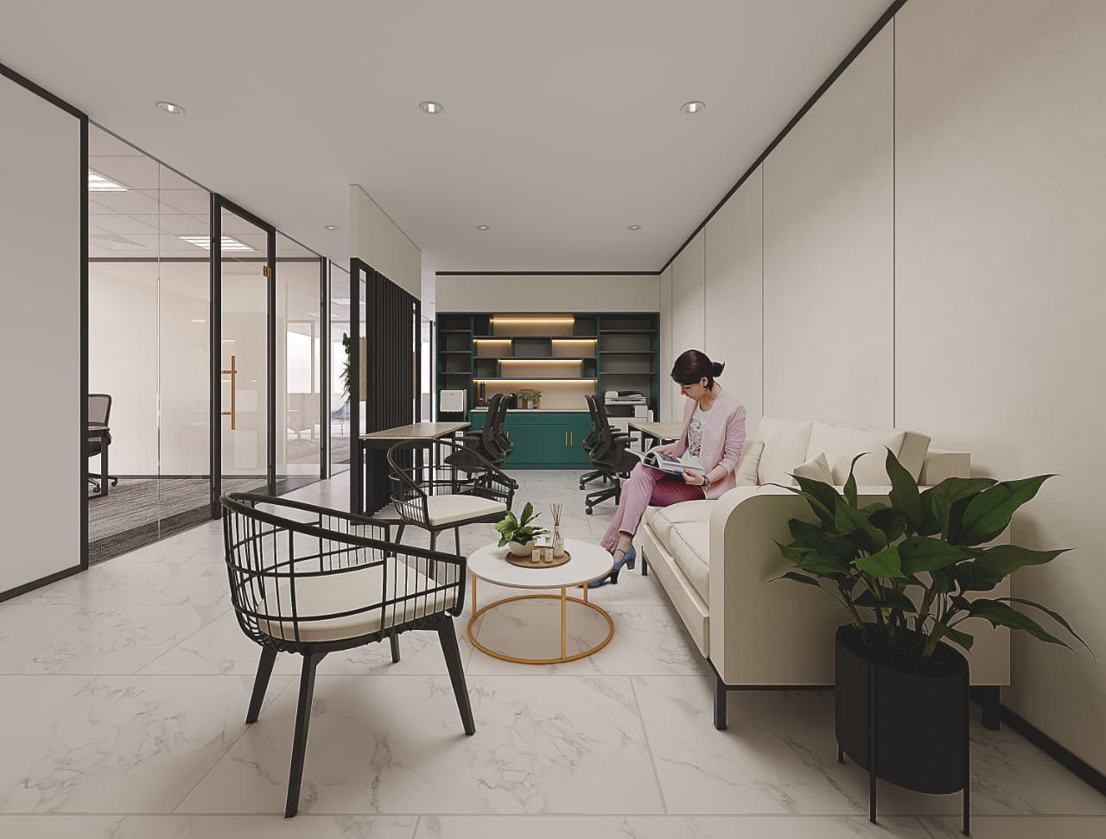
Your Business Needs…
Affordable but quality office, strategic location with various facilities??
Establishment of a business entity, easy and cheap licensing?
Mailing address ?

Slide 3
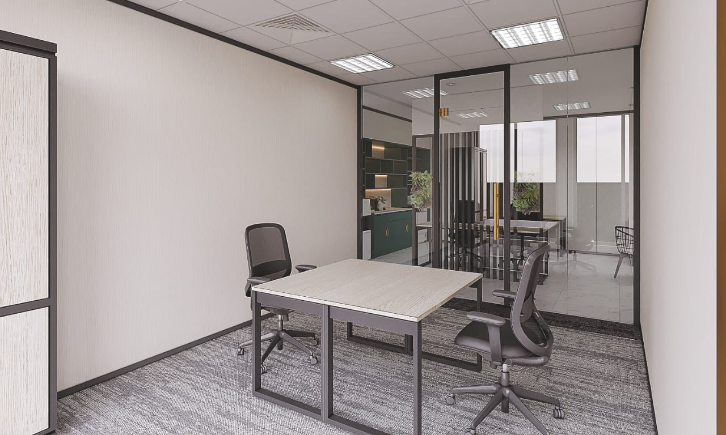


Financial Suite provide a place for an office and rent an address at an affordable cost.
Equipped with the presence of a Financial lounge, Financial Hall, and Financial Gym that can support your various needs.
We have a team that is committed to be able to provide the best service.

Slide 4

Our services
The services we have are legal aspects that are needed by business people who are just starting a business or those who are already running, with the aim of protecting their business.
Service Office, Virtual Office, Meeting Room, dan Co-working Space
Establishment of a Business Entity

Slide 5

Office Rent and Licensing
FAST
Process with effective time
AFFORDABLE
The price offered is cheaper
HIGH QUALITY
Worked by a professional partner
according to the field
.

Slide 6


LAYANAN KAMI ON DEMAND…
Special Permit
Notary and Lawyer
Tax Services
Financial Hall, Financial Gym dan Financial Lounge Jakarta

Slide 7


Call Us
Financial Suite
☎ 021 - 2505090
 financialsuite@fs.co.id
www.financialsuite.com

